Slide 1
Notes:
new

Slide 2
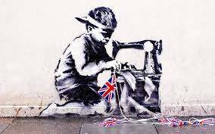
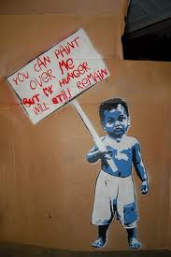
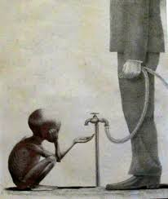
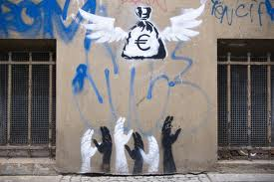
ART
The year 8’s are working on an ‘Issues’ project – looking at themes like the environment, child slavery, poverty, animal cruelty and war
In groups they are creating their own Banksy style graffiti

Slide 3
Dance
Year 7's will be focusing on Dances from around the world. Looking at the contrasts and similarities in culture through movement and performance. (This will continue throughout the year so that each tutor group can experience it)

Slide 4
D&T
Upper school students will be considering the effect of the demand for materials upon the environment and how sources can be managed to enable sustainability.

Slide 5
Drama
Year 11s will be working on a topic linked to Homelessness.
Why people in other countries are made homeless through no fault of their own.
This helps students to understand the feelings and issues connected with an aspect of today’s world.

Slide 6
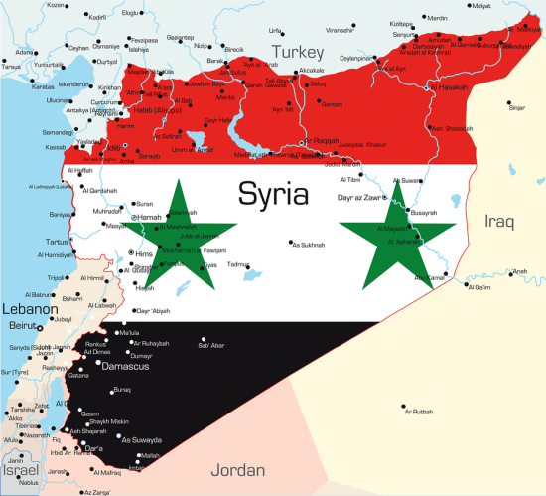
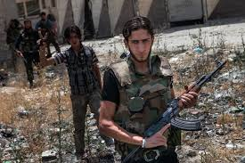
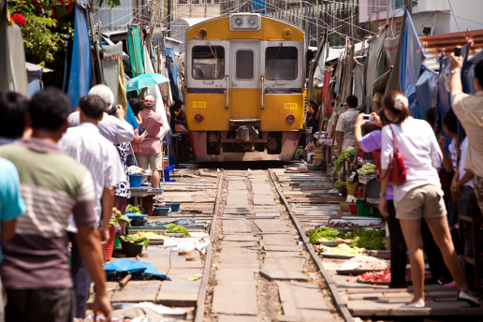
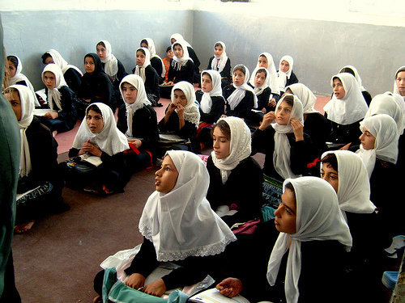
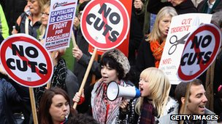
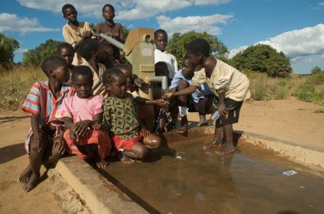
One World Week
Year 7 are studying conflict poetry and novel. Students will be looking at world affairs and linking them to creative writing.
Year 9 will be looking at Less Economically Developed Countries and how tourism can affect them. This is in the travel writing unit.
English Department
Year 8 will be linking OWW to the campaign and non-fiction unit of work. They will also be doing Speaking & Listening activities, discussing girls’ education in Iran
Notes:
New

Slide 7
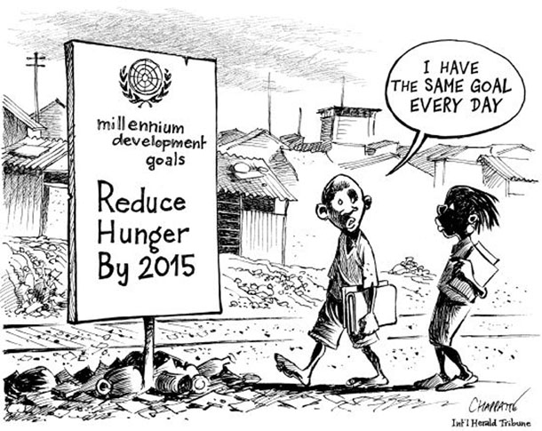
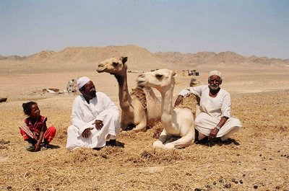
During one World Week Geography
Year 9 will look at Global development patterns and compare countries using social and economic data.
Year 8 – Are looking at the delicate balance of life within the desert ecosystem and how people have adapted to live there.

Slide 8
History
Some of year 9 will be looking at the rise of Adolf Hitler and the causes of the Second World War which saw hostilities across the globe.
Year 8 will be looking at the experience of the French during a revolution that still has an impact on the world today.

Slide 9
Maths
The Maths Department will be looking at the typical salaries for a range of jobs in the UK.
These will then be compared to salaries across the world to place them in a global context.
Notes:
New slide

Slide 10
Media Studies GCSE
Year 10 & 11 students will do a starter on how the media encourages us to aspire to a certain image or possess certain brands, rather than aspiring to being a better person.

Slide 11
Modern Foreign Languages
A number of Year 9 MFL teachers have studied weather as a mini topic with students in several languages. In OWW students will look at this in the context of climate change and global weather extremes/disasters!

Slide 12
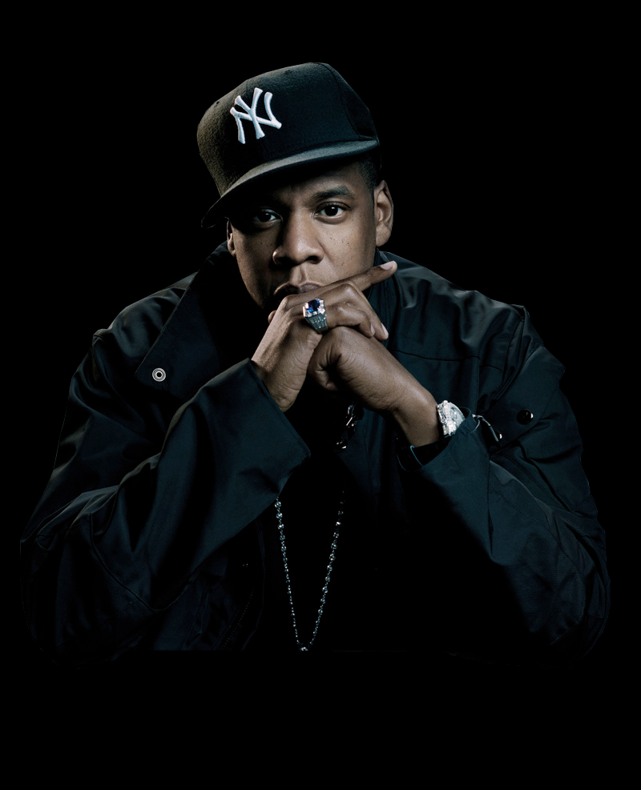
Music
Year 7 Students will be learning about different styles of music from countries around the world including; China, India, Africa and Brazil.
Year 8 Students are composing songs in an Urban style, writing lyrics highlighting issues from around the world and the need for global unity on these issues.

Slide 13
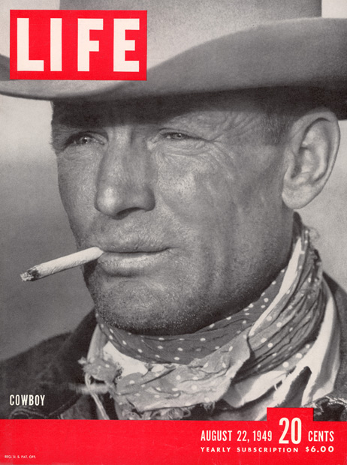
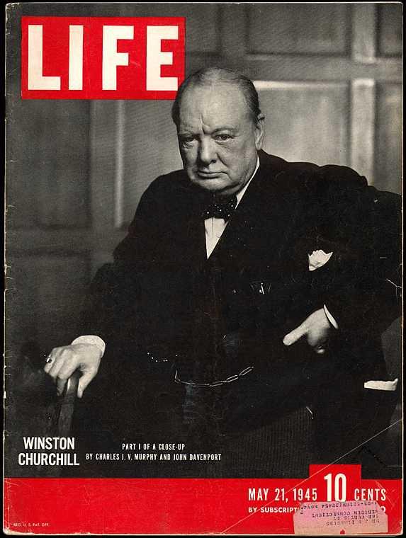
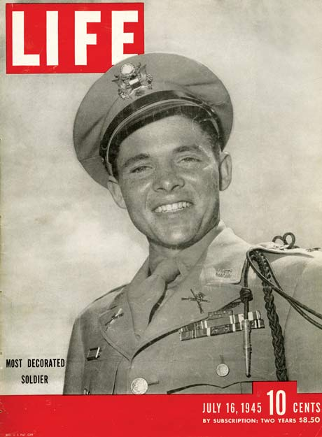
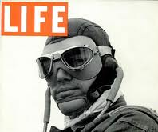
Photography
Year 10 Students will be looking at the work of ‘Life Magazine’ and the ways in which its photojournalists lived with people and infiltrated gangs to get the story for their readers around the world. They will then produce an article inspired by the magazine on a local news story.

Slide 14
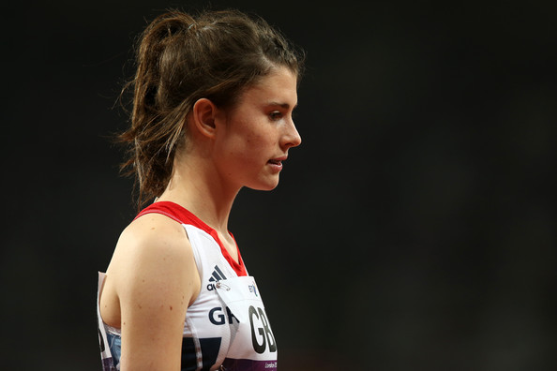
Physical Education
Year 8 students will be looking at opportunities for getting involved in an Inter-Tutor competition and how this can help develop relationships within a tutor group.
Notes:
New slide

Slide 15
PSRE
Year 9 students are looking at ‘Sanctity of Life’ and will be studying issues related to war and conflict and the impact on life.

Slide 16
Science
"Hungry for clean water."
A lesson and a research project with Year 8s on clean water systems and diseases associated with it. Or design a solution activity about water.

Slide 17
Support for Learning
Support for Learning will be looking at vocabulary from the materials for ‘Living in One World’. Year 8 students will be trying out the drama-presentation ‘Saving our World’. Students will also be completing the challenge word search from the OWW materials.

Slide 18
One World Week
Aims to make us more aware.
Aims to help us see that we can make a difference.
Aims to bring us closer together.
Aims to make us THINK and then ACT.
What can you do to make it a fairer world?
Notes:
New slide

Slide 19
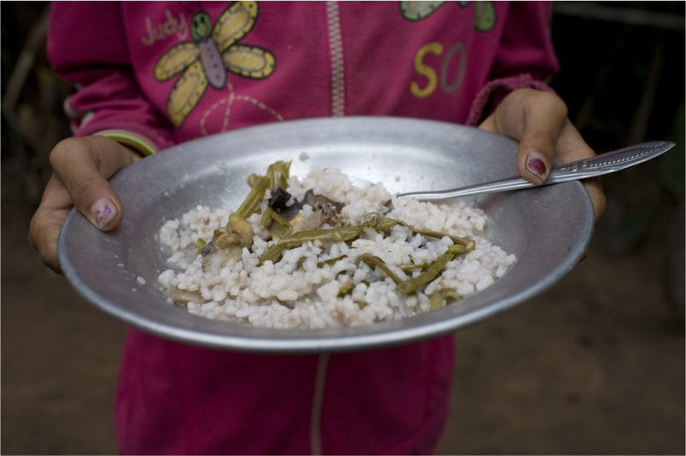
More than enough for ONE WORLD
Notes:
New slide

